Slide 1

Start Game

Slide 2
Greeting
Food
Drinks
Sports
Time
Places
\ 200
\ 200
\ 200
\ 200
\ 200
\ 200
\ 400
\ 400
\ 400
\ 400
\ 400
\ 400
\ 600
\ 600
\ 600
\ 600
\ 600
\ 600
\ 800
\ 800
\ 800
\ 800
\ 800
\ 800
\ 1000
\ 1000
\ 1000
\ 1000
\ 1000
\ 1000

Slide 3
⤵
Greeting
Where are you from?
\ 200
Show Answer

Slide 4
⤵
Greeting
Japan
\ 200

Slide 5
⤵
Greeting
Can you say 2 things you like?
\ 400
Show Answer

Slide 6
⤵
Greeting
I like ___ and ___.
\ 400

Slide 7
⤵
Greeting
Can you say all the weathers?
\ 600
Show Answer

Slide 8
⤵
Greeting
Sunny, Cloudy, Snowy, Rainy
\ 600

Slide 9
⤵
Greeting
Can you say all the days in the week?
\ 800
Show Answer

Slide 10
⤵
Greeting
Monday, Tuesday, Wednesday, Thrusday, Friday, Saturday, Sunday
\ 800

Slide 11
⤵
Greeting
Can you say all the greetings?
\ 1000
Show Answer

Slide 12
⤵
Greeting
Hello. Hi. Good Morning. Goodbye. See you.
\ 1000

Slide 13
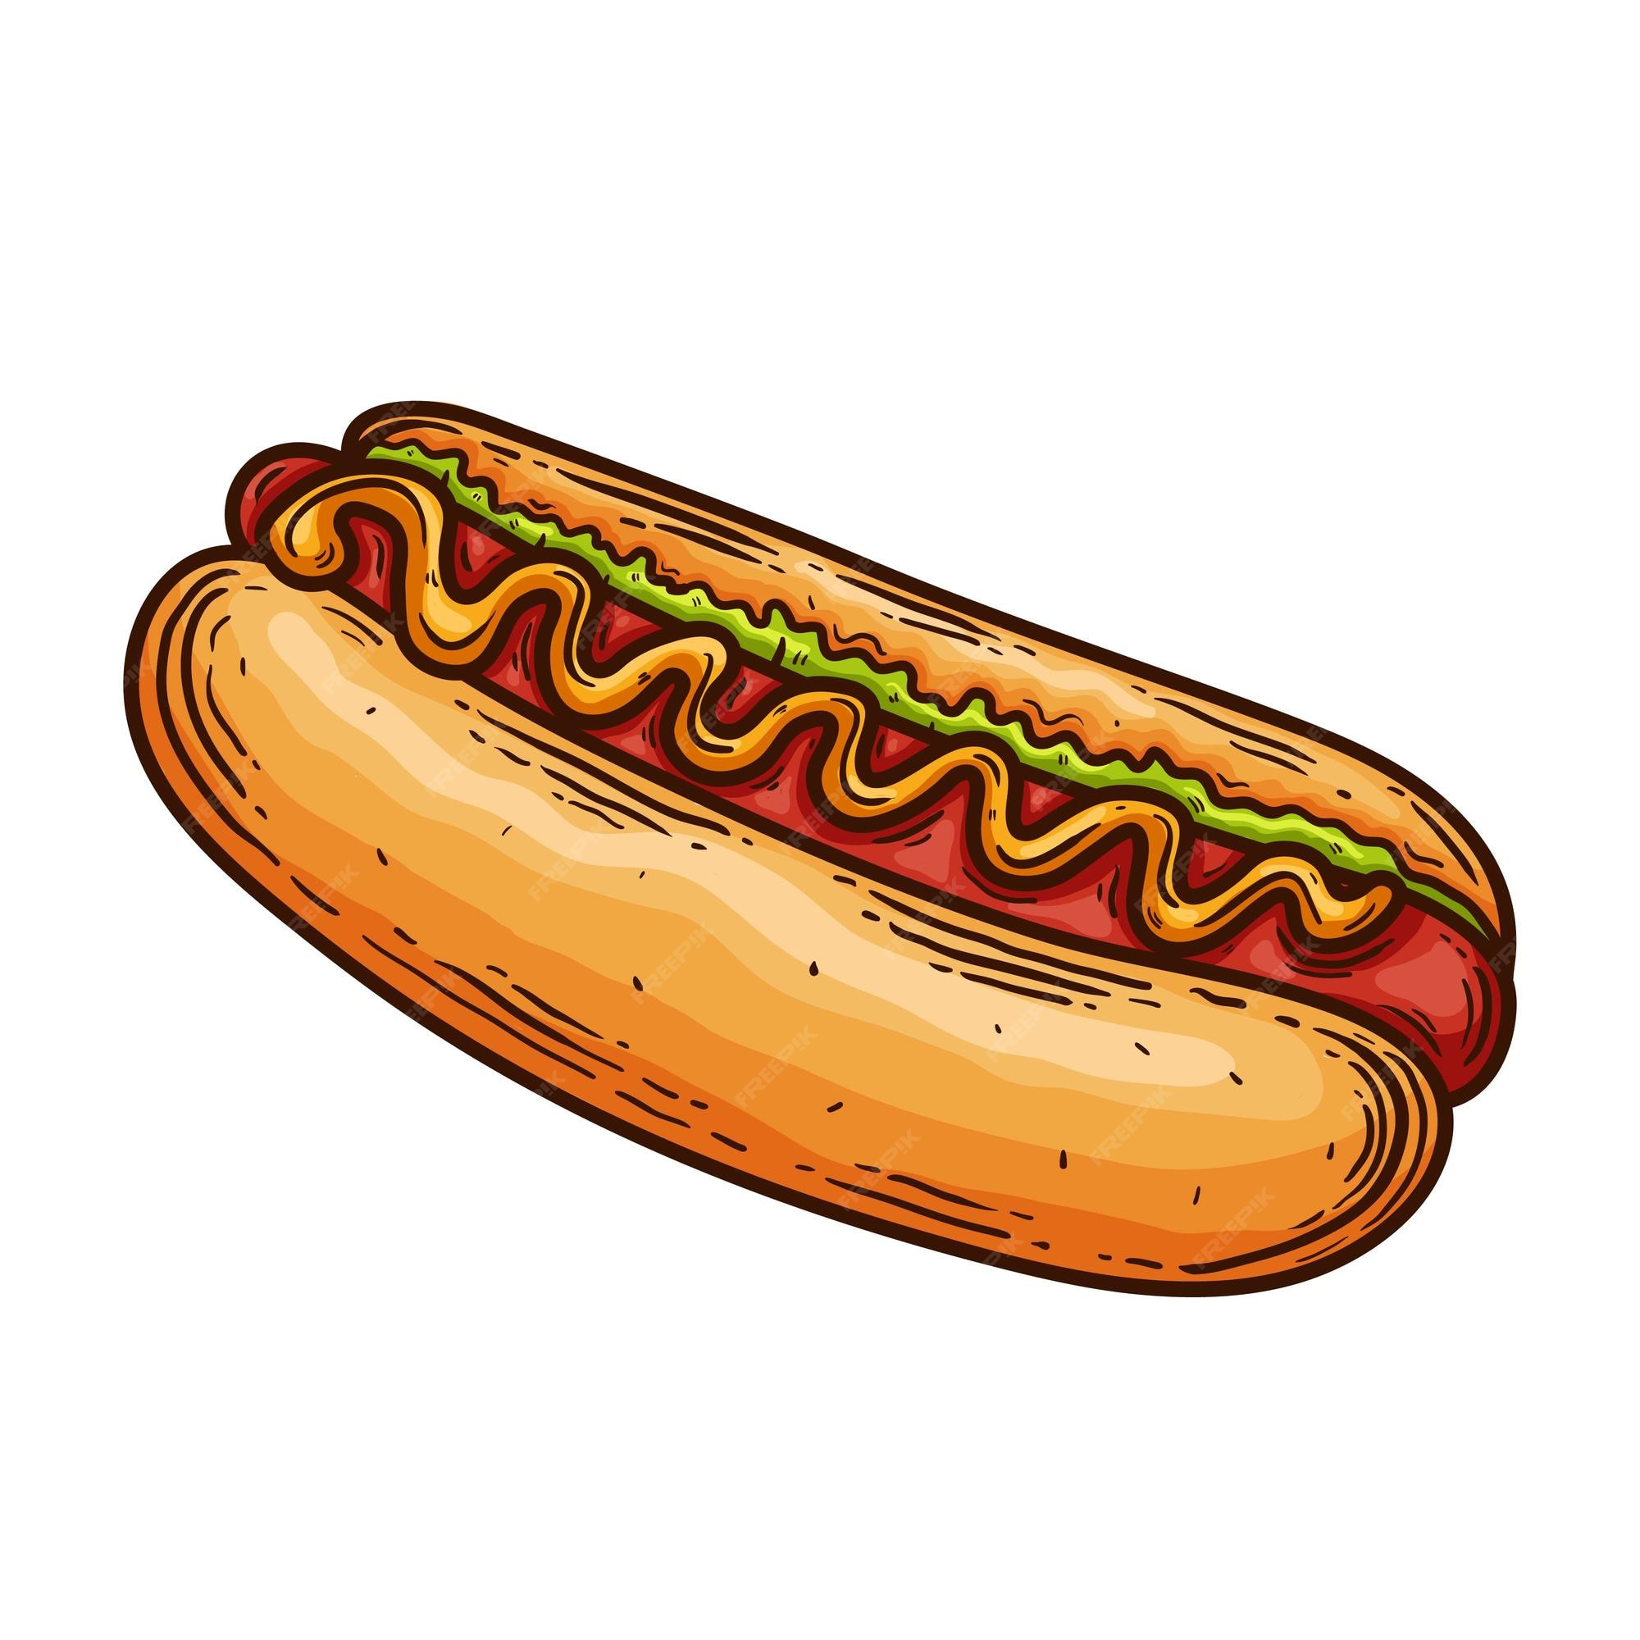
⤵
Food
\ 200
Show Answer

Slide 14
⤵
Food
Hot Dog
\ 200

Slide 15

⤵
Food
Food
\ 400
Show Answer

Slide 16
⤵
Food
Shrimp
\ 400

Slide 17
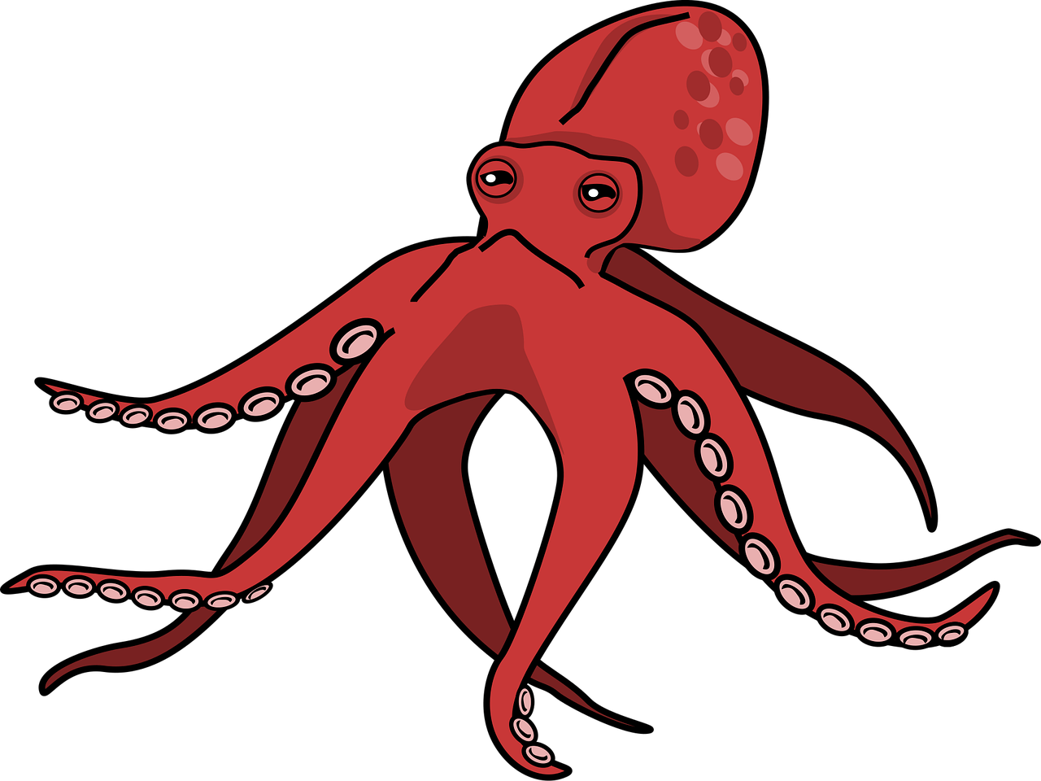
⤵
Food
\ 600
Show Answer

Slide 18
⤵
Food
Octopus
\ 600

Slide 19
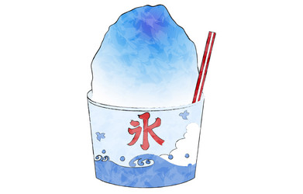
⤵
Food
\ 800
Show Answer

Slide 20
⤵
Food
Shaved Ice
\ 800

Slide 21
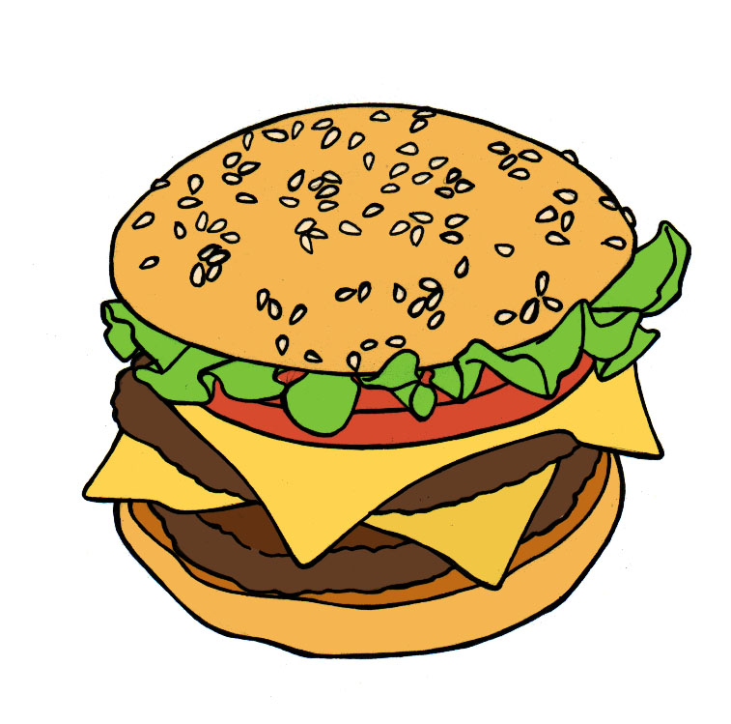
⤵
Food
\ 1000
Show Answer

Slide 22
⤵
Food
Cheeseburger
\ 1000

Slide 23

⤵
Drinks
\ 200
Show Answer

Slide 24
⤵
Drinks
Tea
\ 200

Slide 25

⤵
Drinks
Drinks
\ 400
Show Answer

Slide 26
⤵
Drinks
Juice
\ 400

Slide 27

⤵
Drinks
\ 600
Show Answer

Slide 28
⤵
Drinks
Green Tea
\ 600

Slide 29
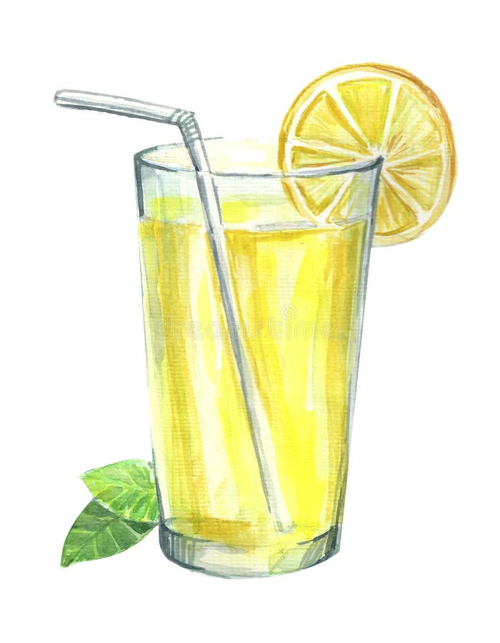
⤵
Drinks
\ 800
Show Answer

Slide 30
⤵
Drinks
Lemonade
\ 800

Slide 31

⤵
Drinks
\ 1000
Show Answer

Slide 32
⤵
Drinks
Hot Chocolate
\ 1000

Slide 33
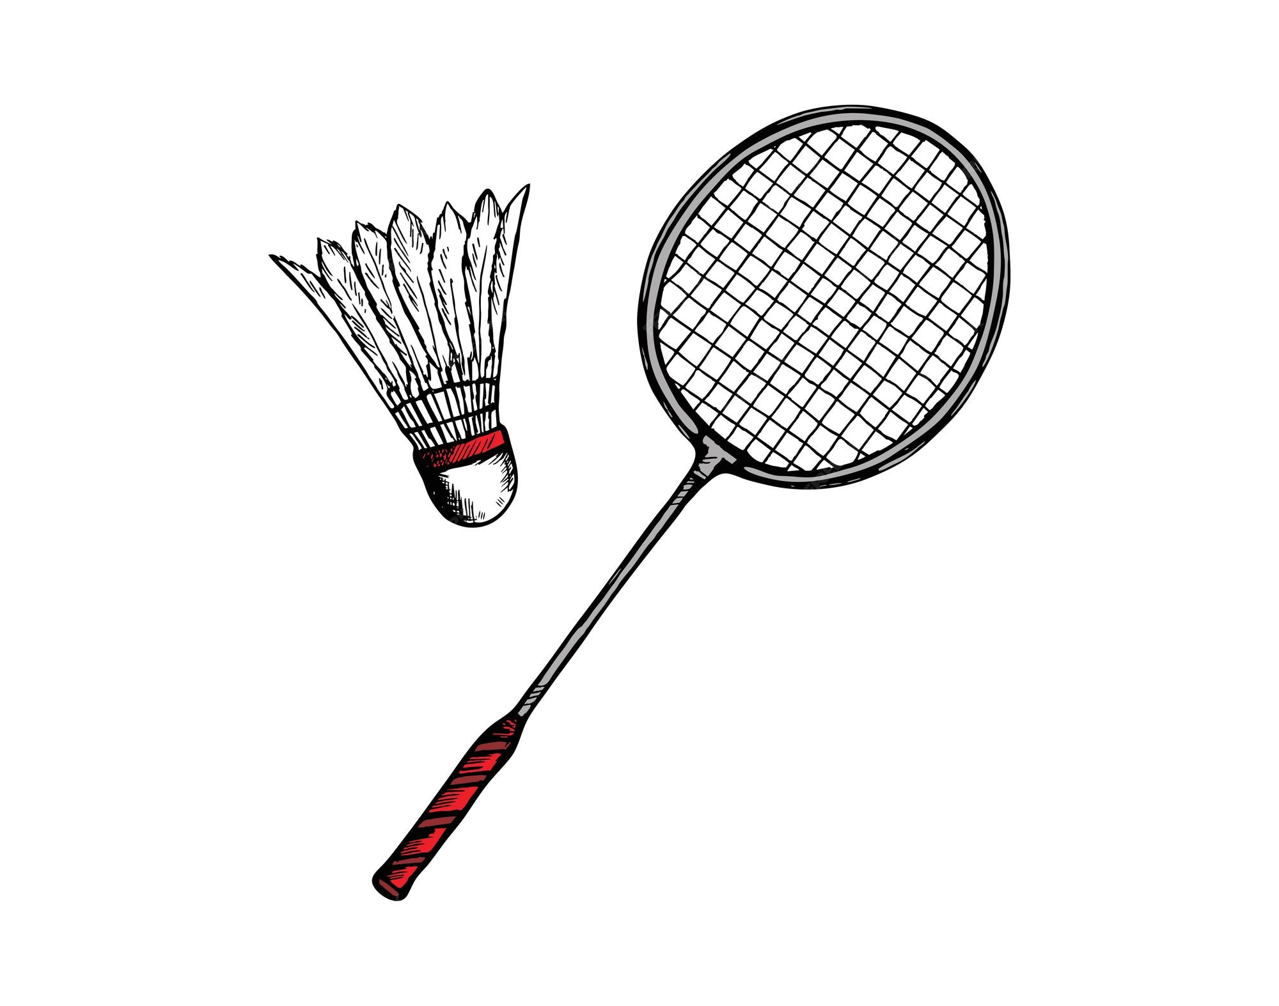
⤵
Sports
\ 200
Show Answer

Slide 34
⤵
Sports
Badminton
\ 200

Slide 35
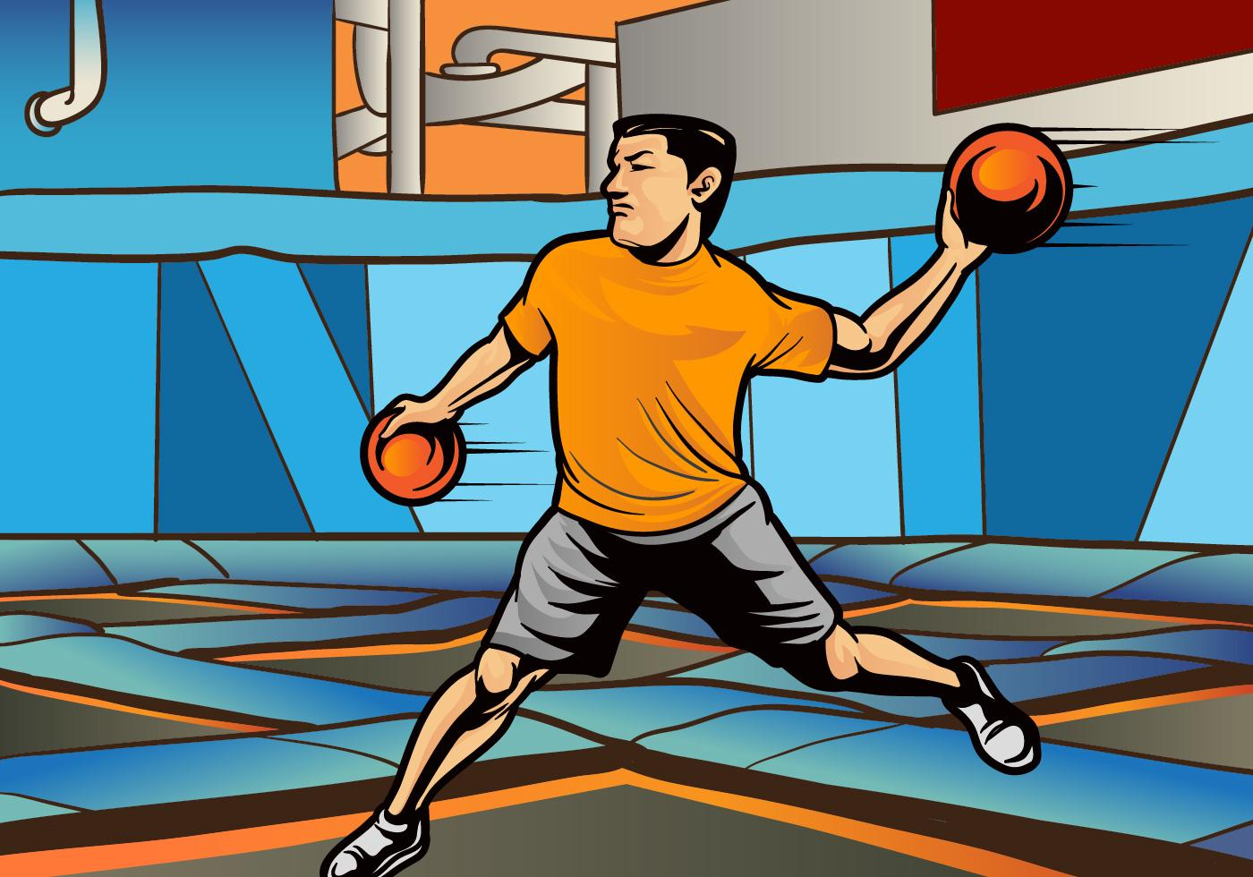
⤵
Sports
Sports
\ 400
Show Answer

Slide 36
⤵
Sports
Dodgeball
\ 400

Slide 37
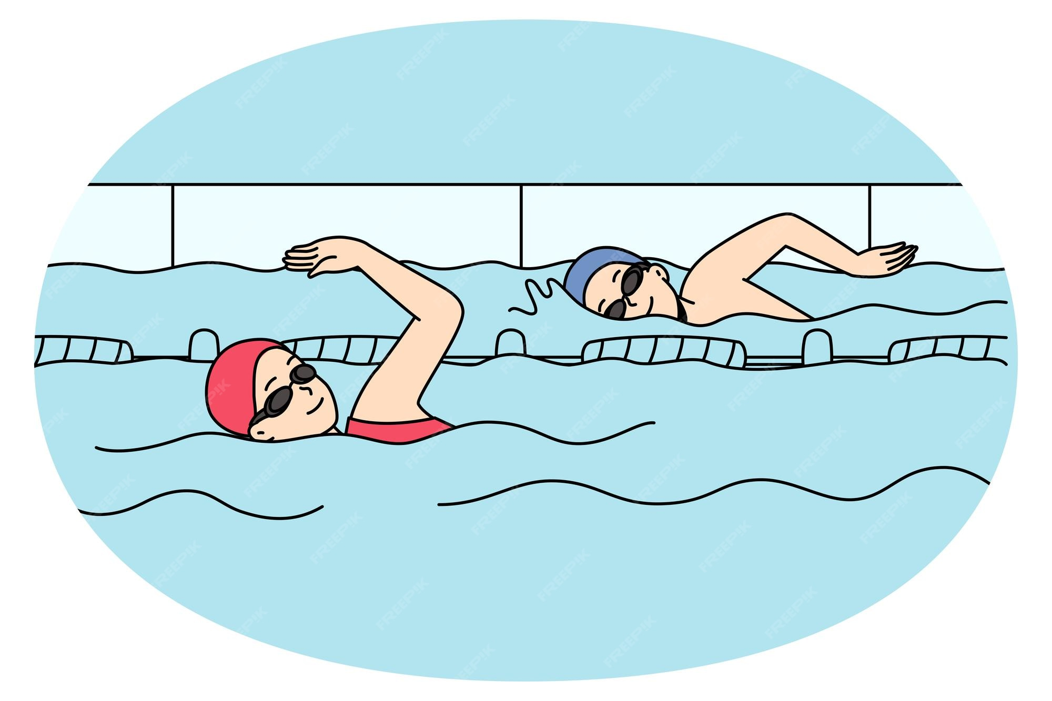
⤵
Sports
\ 600
Show Answer

Slide 38
⤵
Sports
Swimming
\ 600

Slide 39
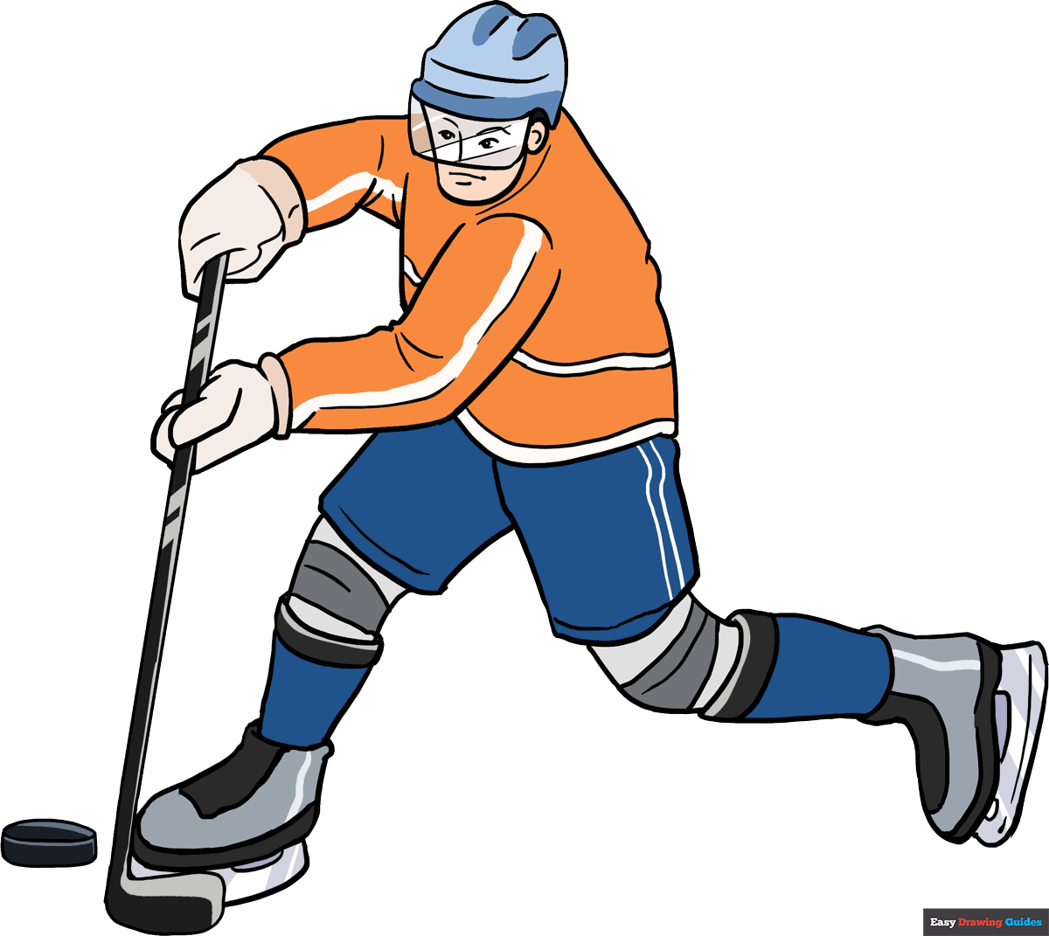
⤵
Sports
\ 800
Show Answer

Slide 40
⤵
Sports
Ice Hockey
\ 800

Slide 41
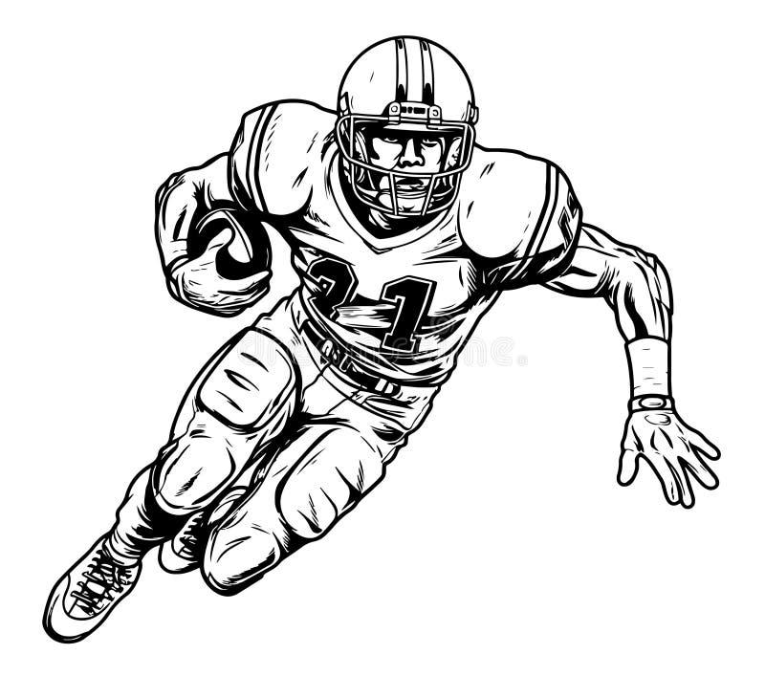
⤵
Sports
\ 1000
Show Answer

Slide 42
⤵
Sports
American Football
\ 1000

Slide 43
⤵
Time
What time is this? 6:00
\ 200
Show Answer

Slide 44
⤵
Time
Six o’ Clock
\ 200

Slide 45
⤵
Time
What month is this?
7月
Time
\ 400
Show Answer

Slide 46
⤵
Time
July
\ 400

Slide 47

⤵
Time
What season is this?
\ 600
Show Answer

Slide 48
⤵
Time
Autumn/Fall
\ 600

Slide 49
⤵
Time
How do you say this date? 十月二十日
\ 800
Show Answer

Slide 50
⤵
Time
October Twentieth
\ 800

Slide 51
⤵
Time
What time is this?
19:48
\ 1000
Show Answer

Slide 52
⤵
Time
It’s seven forty-eight P.M.
\ 1000

Slide 53

⤵
Places
\ 200
Show Answer

Slide 54
⤵
Places
School
\ 200

Slide 55

⤵
Places
Places
\ 400
Show Answer

Slide 56
⤵
Places
Germany
\ 400

Slide 57
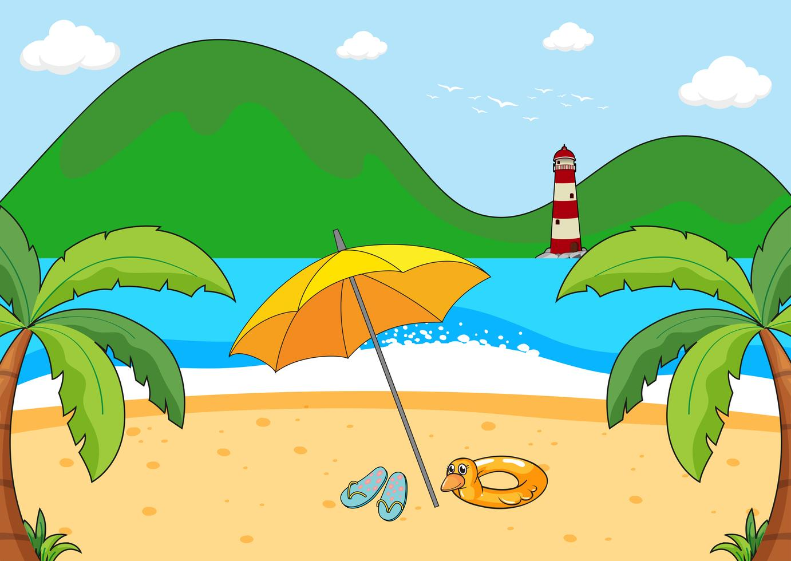
⤵
Places
\ 600
Show Answer

Slide 58
⤵
Places
Beach
\ 600

Slide 59
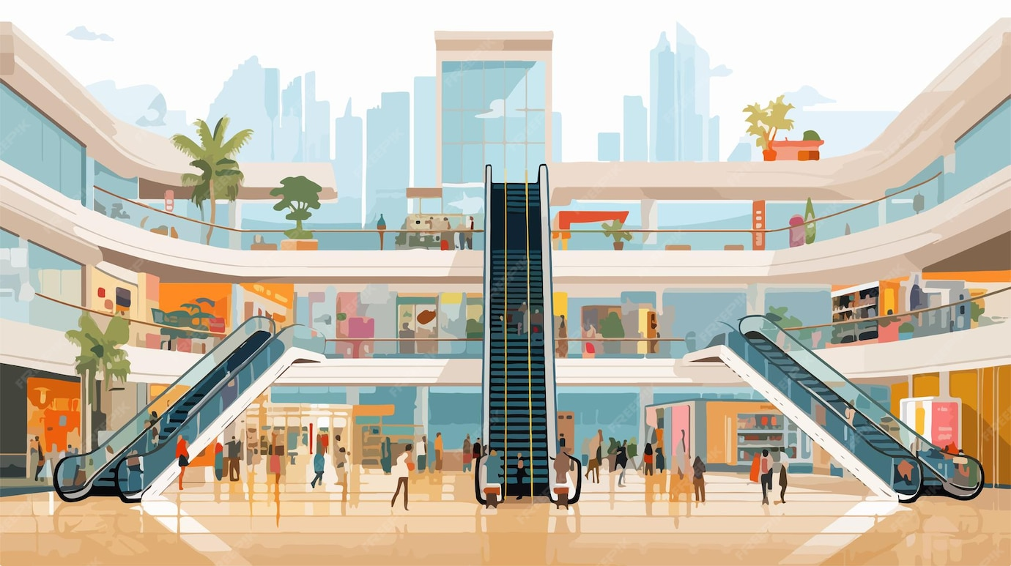
⤵
Places
\ 800
Show Answer

Slide 60
⤵
Places
Shopping Mall
\ 800

Slide 61
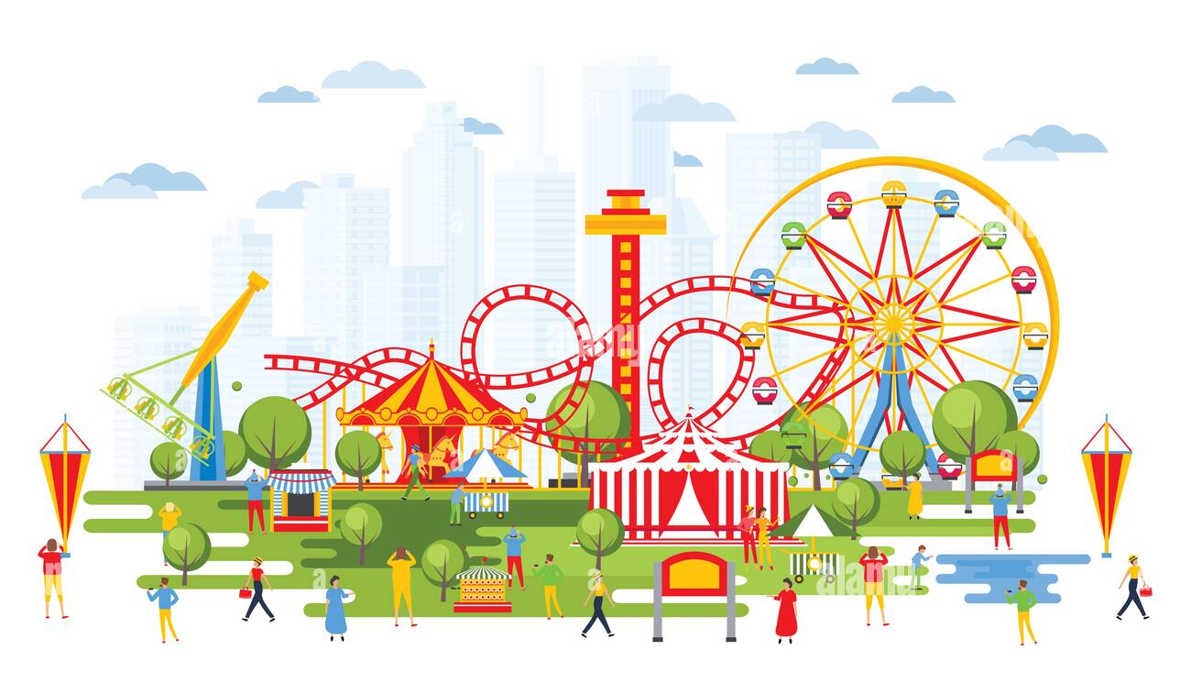
⤵
Places
\ 1000
Show Answer

Slide 62
⤵
Places
Amusement Park
\ 1000

